Slide 1
Units of Energy – Which Burger is Better?
Miss Lum
Year 11 Essentials

Slide 2

Learning Outcomes
Dot Points
1.3.16 Use units of energy for foods, including kilojoules and calories
Contexts
Compare the nutritional energy between different types and amounts of foods and drinks

Slide 3
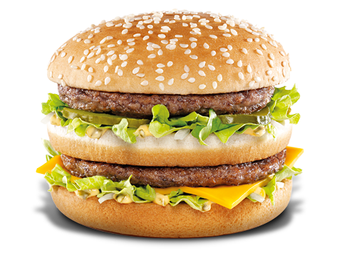
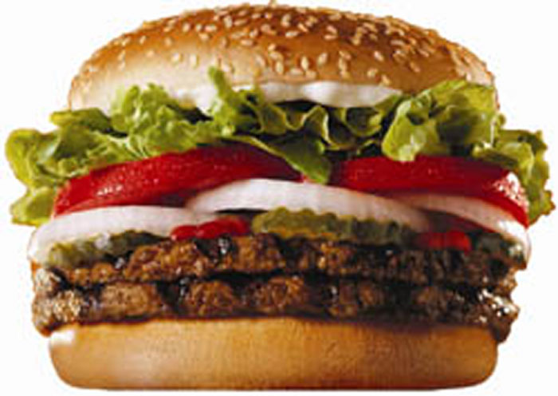
Task
McDonald’s and Hungry Jack’s spend a lot of money on advertising to tell us why we should eat their burgers. They also have healthy options in their menu range. Your task is to investigate the burgers on offer.
VS
This Photo by Unknown Author is licensed under CC BY-SA
This Photo by Unknown Author is licensed under CC BY

Slide 4
Task
Complete the worksheet.
Tasks are not just about the numbers.
Answer the questions and explain your conclusions.

